Slide 1
Introduction to Genome-Wide Association Studies
Jessica Zhou

Slide 2
What is GWAS?
Used to measure associations between genetic polymorphisms (SNPs) and a heritable trait (e.g. height, type-I diabetes, schizophrenia, etc.)
Identify genes/regions involved in driving certain phenotypes
Generate insights into genetic architecture of phenotype
Are many small genetic effects dispersed throughout the genome?
Are a few large effects concentrated in one specific area? (MHC)
Provides data to build models for predicting phenotype from genotype

Slide 3
Some basic relevant terms
Single nucleotide polymorphism (SNP)
Allele vs. locus
Haplotype
Linkage disequilibrium (LD)

Slide 4
Some basic relevant terms
Single nucleotide polymorphism (SNP)
Allele vs. locus
Haplotype
Linkage disequilibrium (LD)

Slide 5
SNPs
Variation in a single nucleotide at a specific position in the genome
Present to some appreciable degree within a population (e.g. >1%)
Drives differences in disease susceptibility
Single nucleotide variant (SNV) is like a SNP without limitations on frequency and can arise in somatic cells

Slide 6
Some basic relevant terms
Single nucleotide polymorphism (SNP)
Allele vs. locus
Haplotype
Linkage disequilibrium (LD)

Slide 7
Allele vs. locus
Allele: variant of a gene
Each cell has two (one per parent)
Locus: location on a chromosome

Slide 8
Some basic relevant terms
Single nucleotide polymorphism (SNP)
Allele vs. locus
Haplotype
Linkage disequilibrium (LD)

Slide 9
Haplotype
Pattern of sequential SNP alleles that tend to occur together on a chromosome
Recombination is rare due to tight linkage
Identifying the statistical associations between SNPs in a haplotype can be used to predict nearby sites given a few alleles

Slide 10
Some basic relevant terms
Single nucleotide polymorphism (SNP)
Allele vs. locus
Haplotype
Linkage disequilibrium (LD)

Slide 11
Linkage disequilibrium
Non-random association of alleles at different loci in a population
Factors:
Natural selection
Rate of genetic recombination
Mutation rate
Genetic drift
Mating
Population structure
Genetic linkage

Slide 12
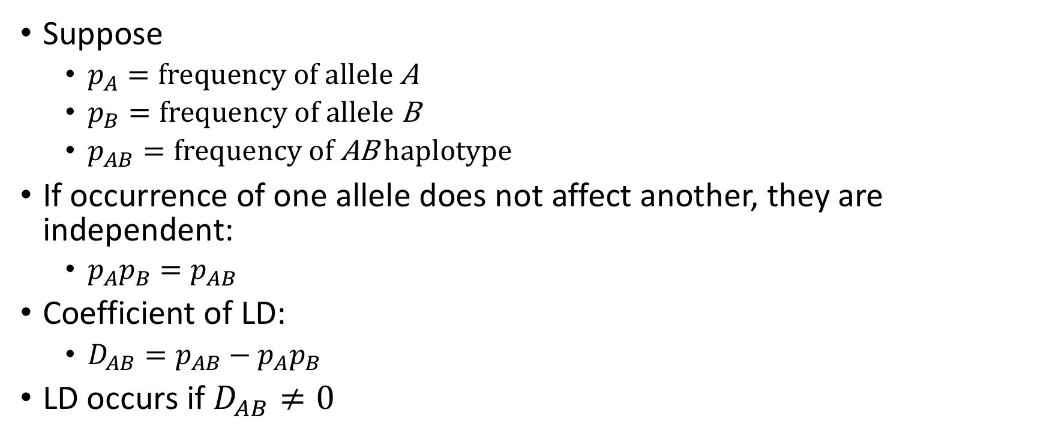
Linkage disequilibrium
Suppose
$p_{A}=\text{frequency} \text{of} \text{allele} \text{A}$
$p_{B}=\text{frequency} \text{of} \text{allele} \text{B}$
$p_{AB}=\text{frequency} \text{of} \text{AB} \text{haplotype}$
If occurrence of one allele does not affect another, they are independent:
$p_{A}p_{B}=p_{AB}$
Coefficient of LD:
$D_{AB}=p_{AB}−p_{A}p_{B}$
LD occurs if $D_{AB}≠0$

Slide 13
How do you find SNP-trait associations?
Cases:
AGAGCAGTCGACAGGTATAGCCTACATGAGATCGACATGAGATCGGTAGAGCCGTGAGATCGACATGATAGCC
AGAGCCGTCGACATGTATAGTCTACATGAGATCGACATGAGATCGGTAGAGCAGTGAGATCGACATGATAGTC
AGAGCAGTCGACAGGTATAGTCTACATGAGATCGACATGAGATCGGTAGAGCCGTGAGATCGACATGATAGCC
AGAGCAGTCGACAGGTATAGCCTACATGAGATCAACATGAGATCGGTAGAGCAGTGAGATCGACATGATAGCC
AGAGCCGTCGACATGTATAGCCTACATGAGATCGACATGAGATCGGTAGAGCCGTGAGATCAACATGATAGCC
AGAGCCGTCGACATGTATAGCCTACATGAGATCGACATGAGATCGGTAGAGCAGTGAGATCAACATGATAGCC
AGAGCCGTCGACAGGTATAGCCTACATGAGATCGACATGAGATCGGTAGAGCAGTGAGATCAACATGATAGTC
AGAGCAGTCGACAGGTATAGCCTACATGAGATCGACATGAGATCTGTAGAGCCGTGAGATCGACATGATAGCC
Controls:
Associated SNP
AGAGCAGTCGACATGTATAGTCTACATGAGATCGACATGAGATCGGTAGAGCAGTGAGATCAACATGATAGCC
AGAGCAGTCGACATGTATAGTCTACATGAGATCAACATGAGATCTGTAGAGCCGTGAGATCGACATGATAGCC
AGAGCAGTCGACATGTATAGCCTACATGAGATCGACATGAGATCTGTAGAGCCGTGAGATCAACATGATAGCC
AGAGCCGTCGACAGGTATAGCCTACATGAGATCGACATGAGATCTGTAGAGCCGTGAGATCGACATGATAGTC
AGAGCCGTCGACAGGTATAGTCTACATGAGATCGACATGAGATCTGTAGAGCCGTGAGATCAACATGATAGCC
AGAGCAGTCGACAGGTATAGTCTACATGAGATCGACATGAGATCTGTAGAGCAGTGAGATCGACATGATAGCC
AGAGCCGTCGACAGGTATAGCCTACATGAGATCGACATGAGATCTGTAGAGCCGTGAGATCGACATGATAGCC
AGAGCCGTCGACAGGTATAGTCTACATGAGATCAACATGAGATCTGTAGAGCAGTGAGATCGACATGATAGTC

Slide 14
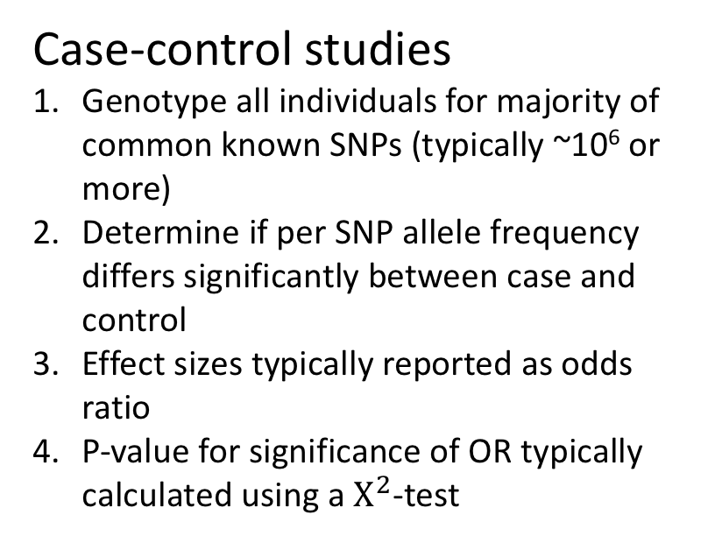
How is GWAS done?
Case-control studies
Genotype all individuals for majority of common known SNPs (typically ~10⁶ or more)
Determine if per SNP allele frequency differs significantly between case and control
Effect sizes typically reported as odds ratio
P-value for significance of OR typically calculated using a $Χ^{2}$-test

Slide 15
How is GWAS done?
Case-control studies
Genotype all individuals for majority of common known SNPs (typically ~10⁶ or more)
Determine if per SNP allele frequency differs significantly between case and control
Effect sizes typically reported as odds ratio
P-value for significance of OR typically calculated using a $Χ^{2}$-test

Slide 16
How is GWAS done?
Case-control studies
Genotype all individuals for majority of common known SNPs (typically ~10⁶ or more)
Determine if per SNP allele frequency differs significantly between case and control
Effect sizes typically reported as odds ratio
P-value for significance of OR typically calculated using a $Χ^{2}$-test

Slide 17
How is GWAS done?
Case-control studies
Genotype all individuals for majority of common known SNPs (typically ~10⁶ or more)
Determine if per SNP allele frequency differs significantly between case and control
Effect sizes typically reported as odds ratio
P-value for significance of OR typically calculated using a $Χ^{2}$-test

Slide 18
Visualizing GWAS results
Manhattan plots

Slide 19
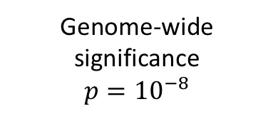
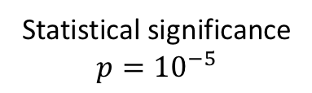
Visualizing GWAS results
Genome-wide significance
$$p={10}^{−8}$$
Manhattan plots
Statistical significance
$$p={10}^{−5}$$

Slide 20
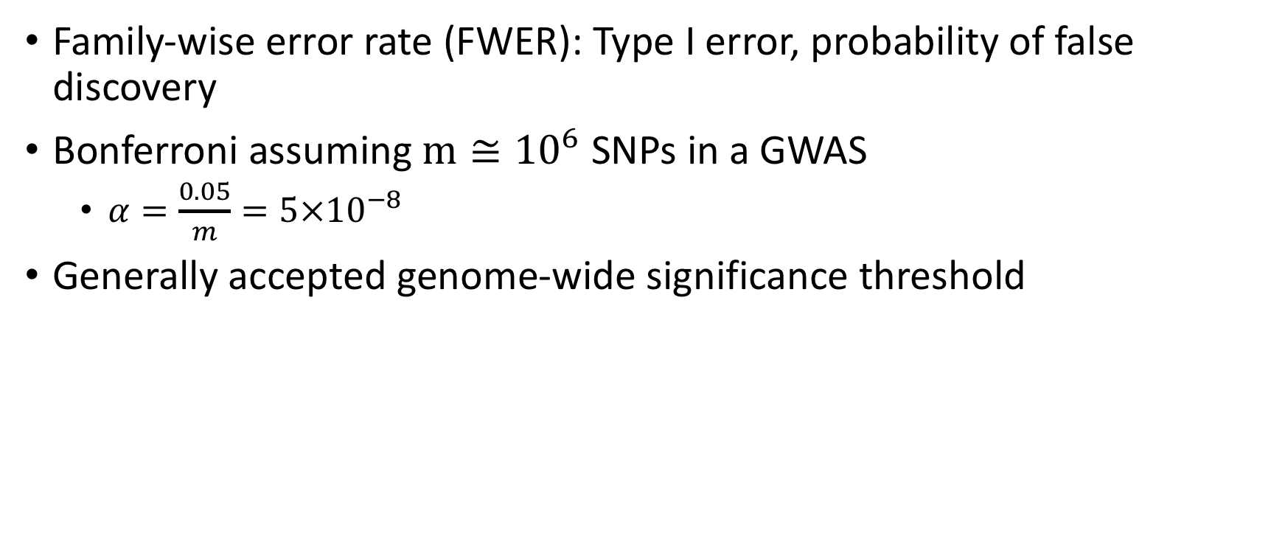
The multiple testing problem
Family-wise error rate (FWER): Type I error, probability of false discovery
Bonferroni assuming $m≅{10}^{6}$ SNPs in a GWAS
$α=\frac{0.05}{m}=5×{10}^{−8}$
Generally accepted genome-wide significance threshold

Slide 21
Population stratification
Account for potentially confounding variables resulting in systematic differences in allele frequencies between subpopulations
Sex, age, geographic/ethnic background
Can imply association actually due to underlying population structure
PCA commonly used for population stratification

Slide 22
More genotypes, more information
Genotyping arrays examine tagged SNPs and do not directly genotype all variation in the genome
Imputation is used to infer initially untyped genetic variants
Infer from haplotypes derived from reference genomes with denser genotyping
Boosts coverage of genomic variation

Slide 23
More genotypes, more information

Slide 24
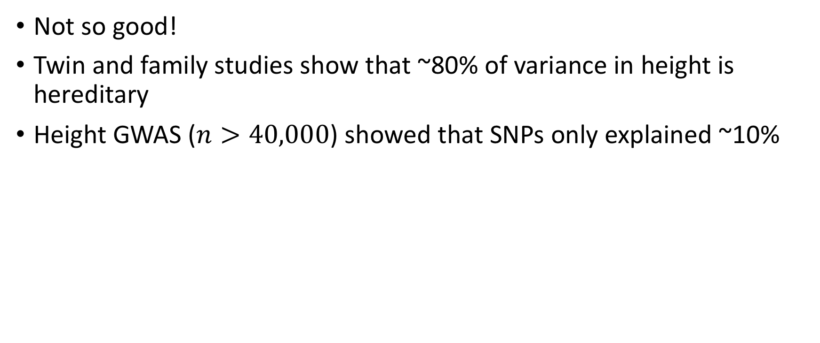
How well does GWAS explain heritability?
Not so good!
Twin and family studies show that ~80% of variance in height is hereditary
Height GWAS ($n>40,000$) showed that SNPs only explained ~10%

Slide 25
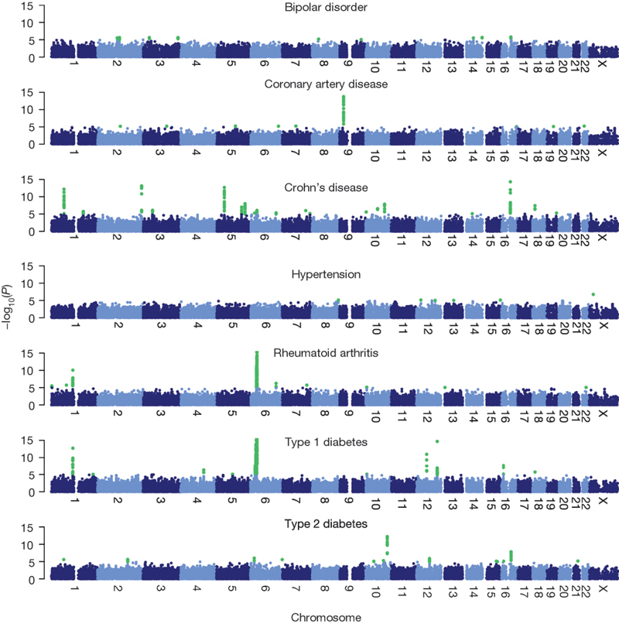
How well does GWAS explain heritability?
WTCCC study of seven diseases on 14,000 cases and 3,000 shared controls found only 13 genome-wide significant findings

Slide 26
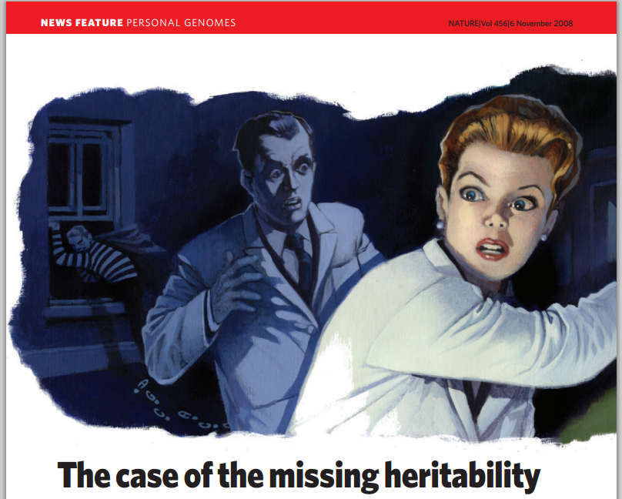
Where is the missing heritability?

Slide 27
Where is the missing heritability?
Theories:
Rare variants not included in GWAS
Complex associations/epistasis
Lack of statistical power – low effect sizes could be due to lack of data
Epigenetic effects actually drive heritability?

Slide 28
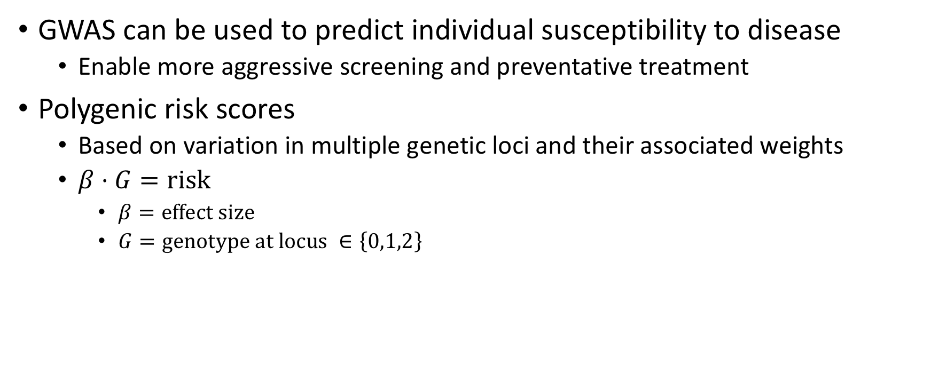
Genetic risk prediction
GWAS can be used to predict individual susceptibility to disease
Enable more aggressive screening and preventative treatment
Polygenic risk scores
Based on variation in multiple genetic loci and their associated weights
$β⋅G=\text{r}\text{isk}$
$β=\text{effect} \text{size}$
$G=\text{genotype} \text{at} \text{locus} ∈\left\{0,1,2\right\}$

Slide 29
In short…
Lots of applications!
Still a lot of questions to answer

Slide 30
Let’s give it a try!

